Slide 1
Medical Insurance premium prediction
Analyzing the impact of lifestyle and medical factors in determining insurance premiums.
NAME : ALIN ANAND
TEAM : 10
DATE : 30/08/2024

Slide 2
Introduction
In the rapidly evolving landscape of healthcare insurance, accurately predicting medical insurance premiums is crucial for insurers.
The findings of this study highlight the significance of lifestyle and medical factors in determining insurance premiums.
This study explores the application of machine learning techniques to predict medical insurance premiums based on given dataset.

Slide 3
Dataset
Contains 20000 entries with 24 diverse features.
The dataset encompasses a wide array of variables such as age, gender, and income, as well as lifestyle factors
Also medical history elements such as pre-existing conditions, average glucose levels, and body mass index are incorporated to enhance the predictive power of the models.

Slide 4
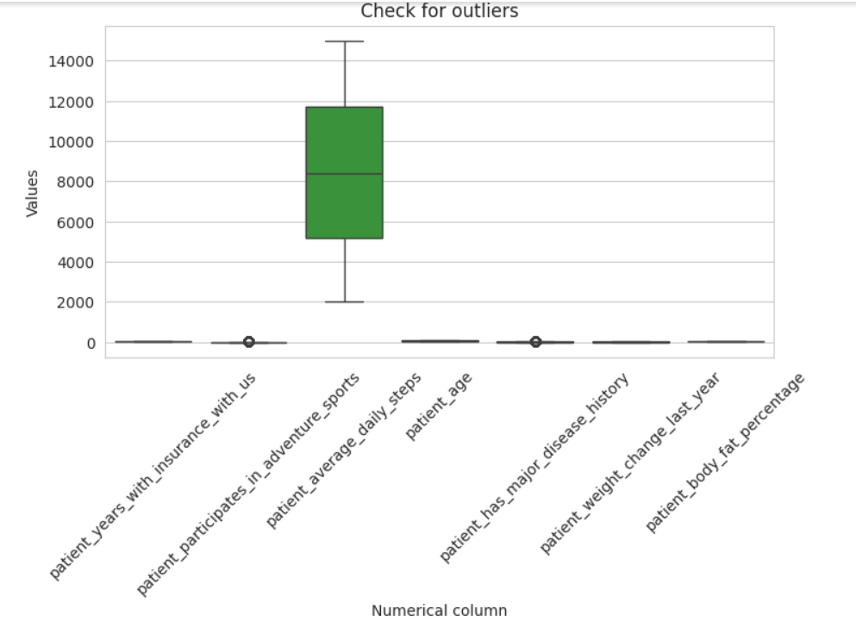
Data preprocessing steps done
Data cleaning.
Feature Engineering.
Data encoding.
Scaling – Min-Max Scaler.

Slide 5
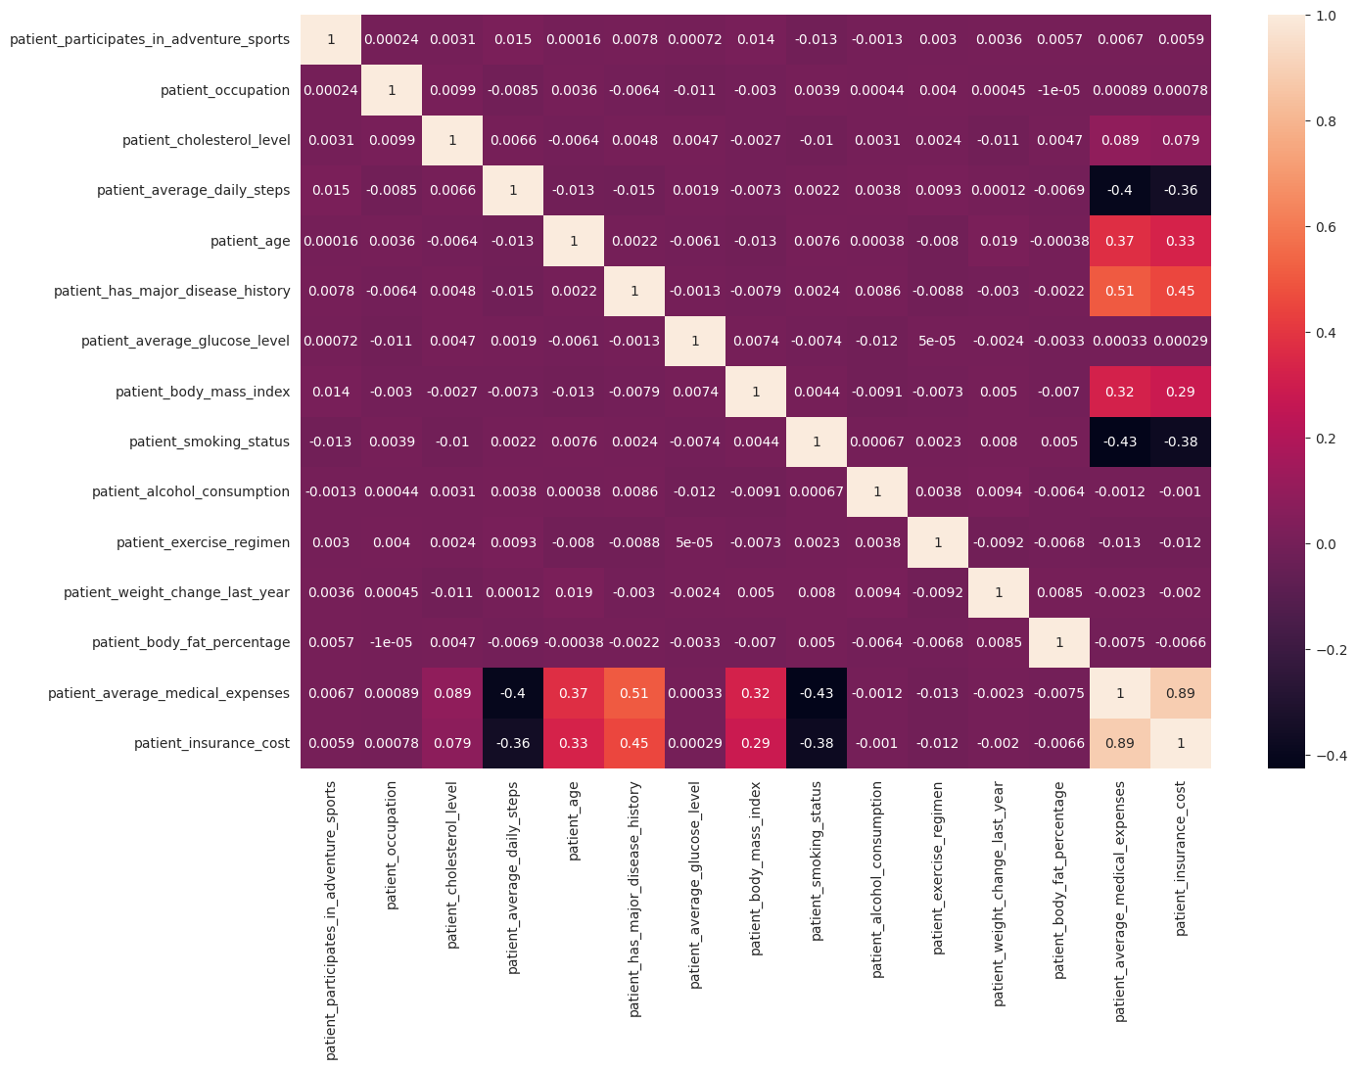
Identifying Co-related columns

Slide 6
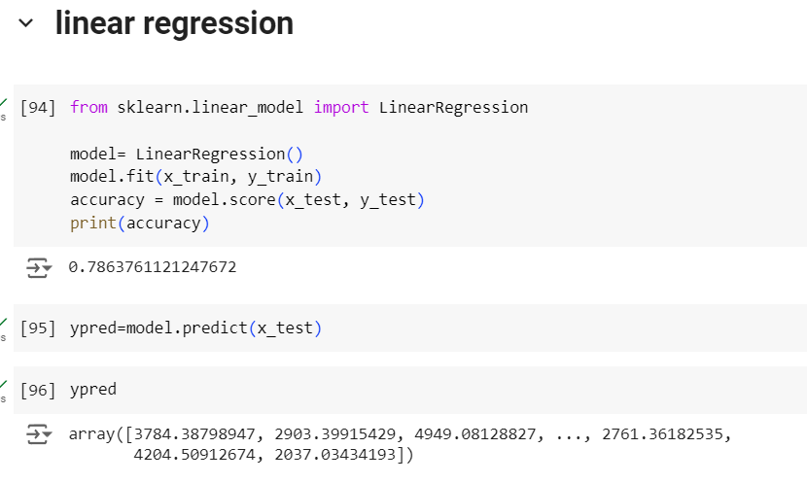
Methods used:
Linear Regression -78%
Random forest – 77%
Support Vector Mechanism- 77%
Approach used : Linear Regression
Model Accuracy : 78%

Slide 7
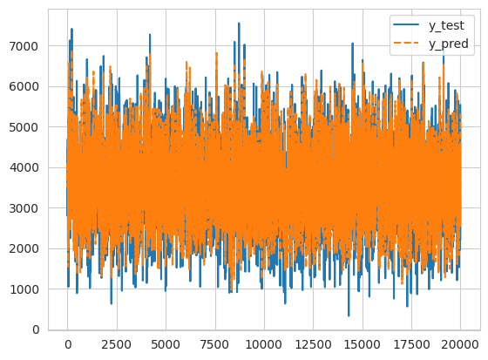
Modeling Techniques
Line plot of the actual and predicted values

Slide 8
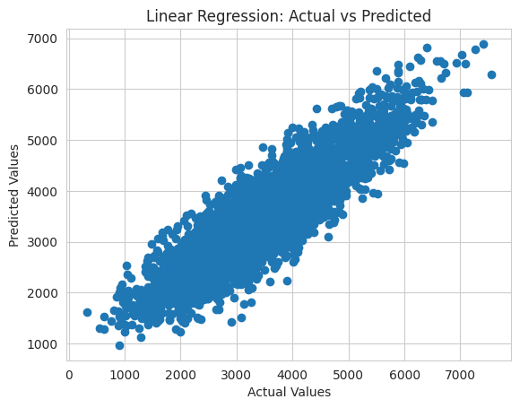
Modeling
Scatter plot of the actual and predicted values

Slide 9
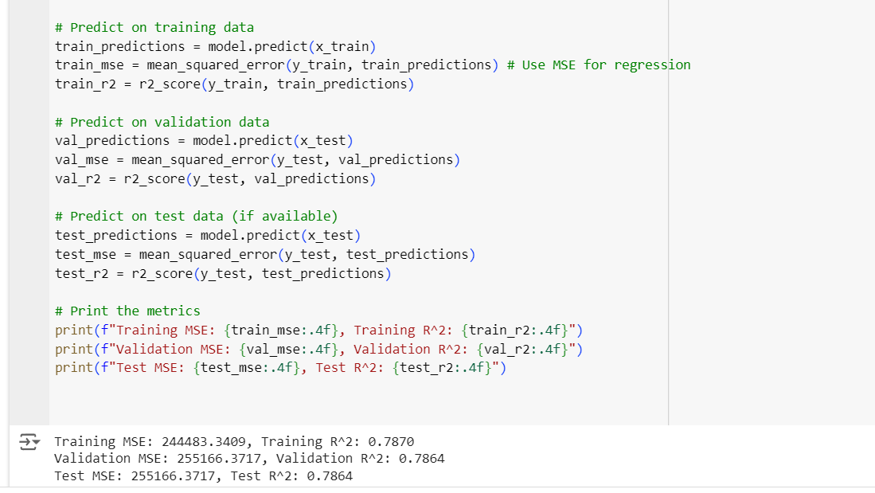
Testing for over fitting model
Training accuracy is not much higher than the validation or test accuracy, the model is not overfitted

Slide 10
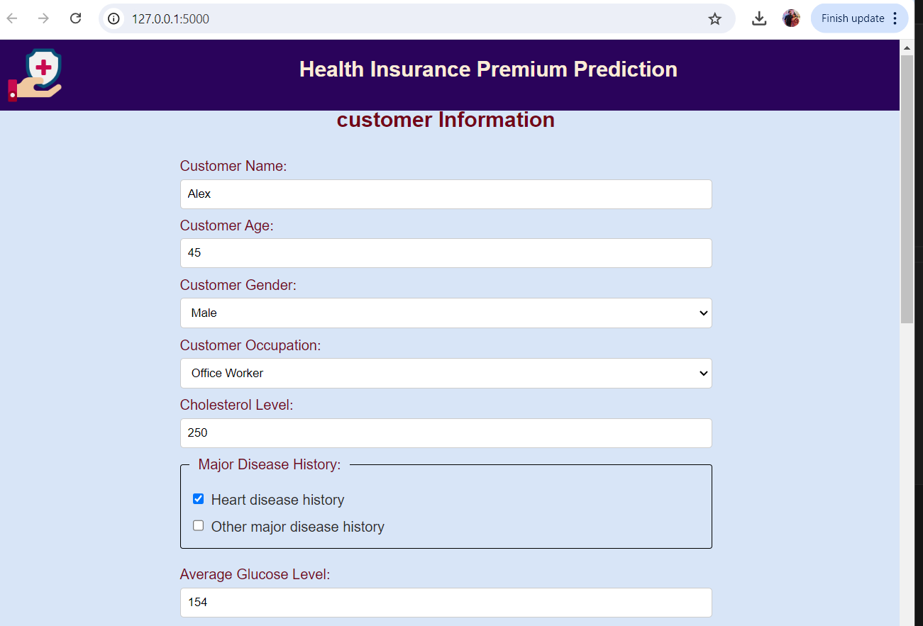
Deploying the ML Model using Flask
Creating a web application that serves predictions based on your trained model.
Receive the customer data from the user and make prediction based on data received.

Slide 11
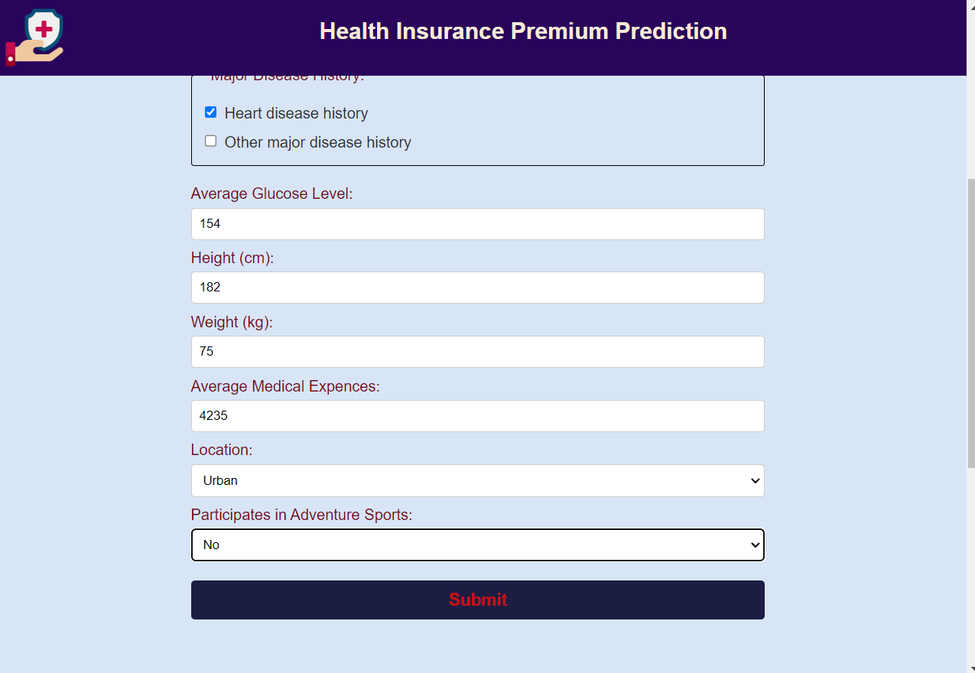
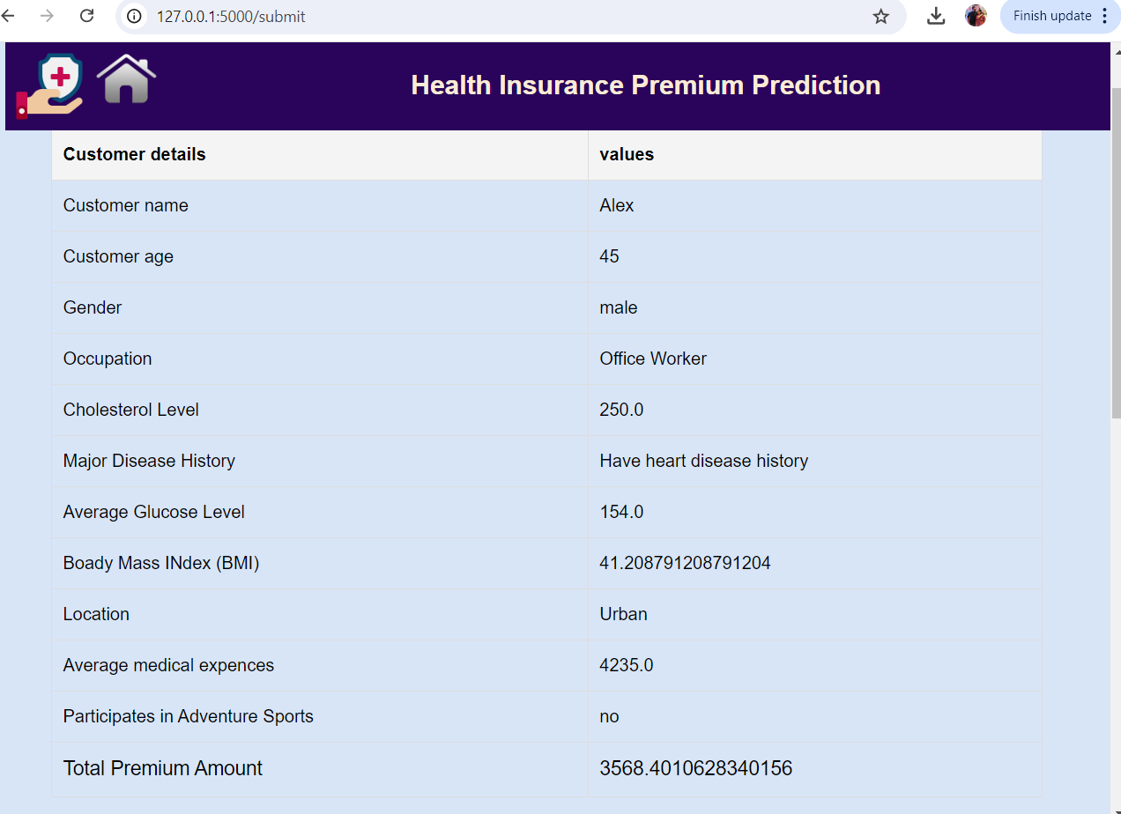
Deploying the ML Model using Flask

Slide 12
Conclusion
The models provide policyholders with a transparent understanding of how their health and lifestyle choices impact their insurance costs.
Insures can provide customers precise and personalized premium calculations based on customer data and thereby enhancing customer satisfaction.

Slide 13

Thank you !

